Slide 1
PF Operator Estimation and Applications in Control
Darshan Gadginmath

Slide 2
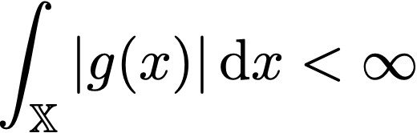
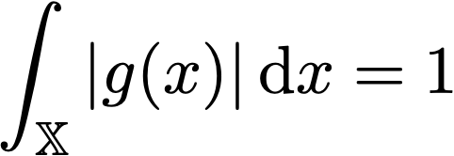
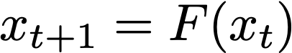
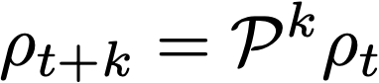
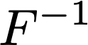
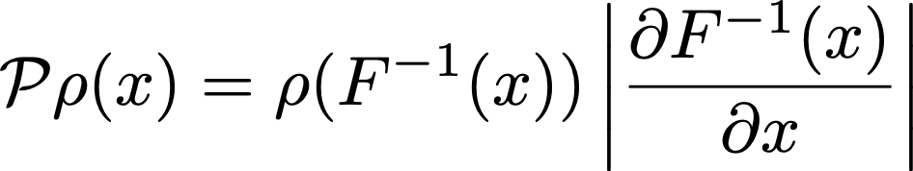
Recap – PF Operator
Propagates L1 functions of dynamical systems
Evolution of densities
Inverstible systems ( is non singular)

Slide 3
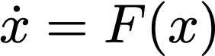
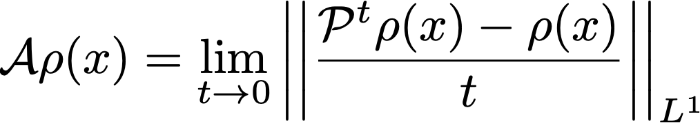
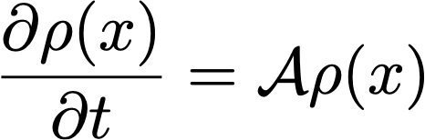
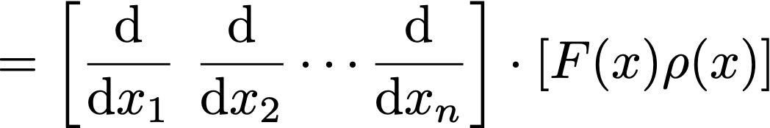
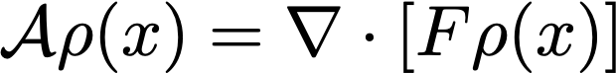
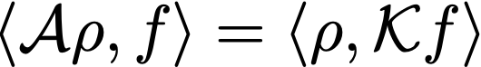
Recap - Infintesimal Generator
Continuous-time system
Infinitesimal generator called the Liouville operator
Adjoint to the Koopman operator

Slide 4
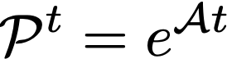
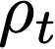
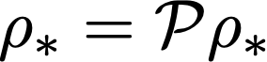
PF operator approximation
Old methods such as Ulam’s method are naïve
New methods are computationally inefficient, implemented in low dimensions
Approximate Liouville operator by finite differences and
Lift nonlinear dynamics to linear dynamics, use closed-form approximations of Wasserstein distance for linear systems.
Our method
Give estimate of evolution of (predict behavior)
Find invariant density (verify alignment)
Computationally efficient even in high dimensions

Slide 5
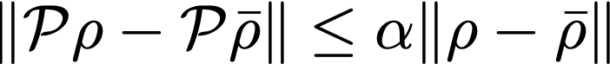
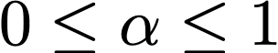
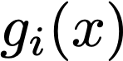
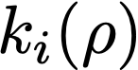
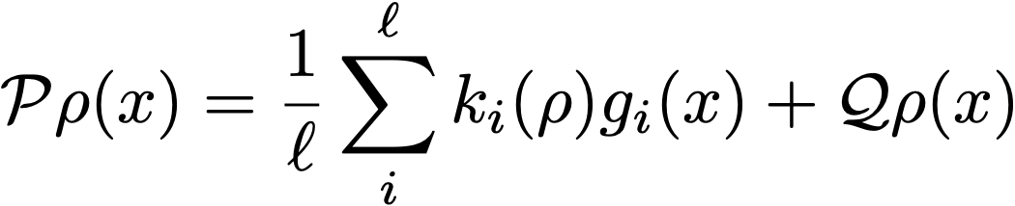
Spectral Decomposition Theorem (SDT)
Constrictive PF operator (stable systems, oscillators, etc.)
There exists a positive integer
functions
functions
such that

Slide 6
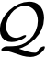
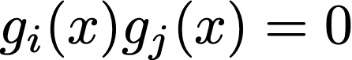
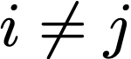
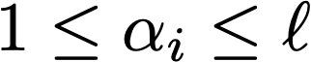
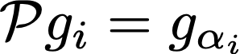
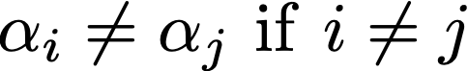
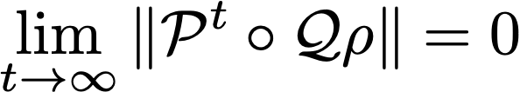
Spectral Decomposition Theorem (SDT)
Properties of , and
Orthogonality of : for all
Permutation of : There exists
Constriction:

Slide 7
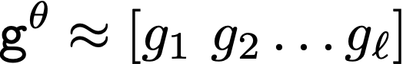
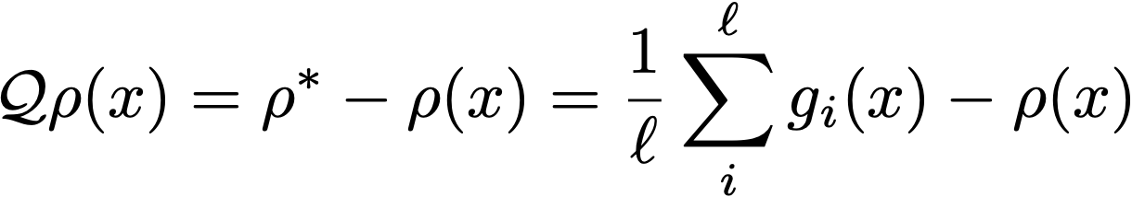
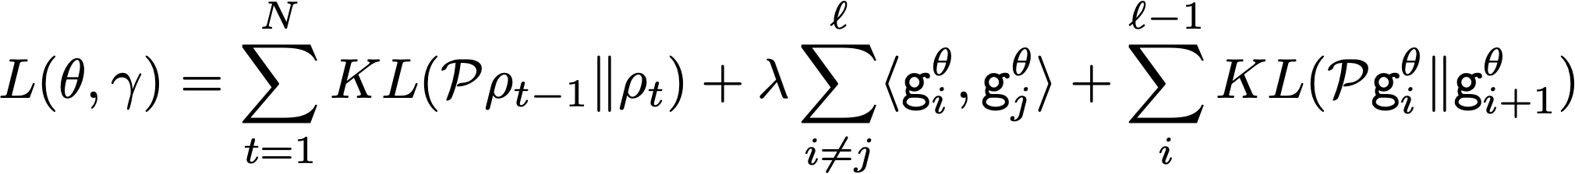
Using the SDT for Estimation
Use two neural networks
Use orthogonality, permutativity and constrictive properties to train NN

Slide 8
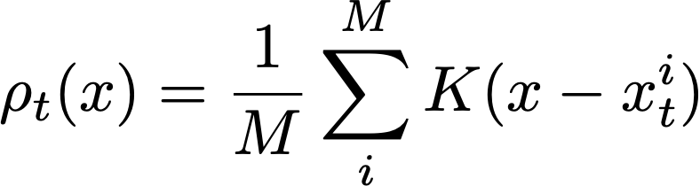
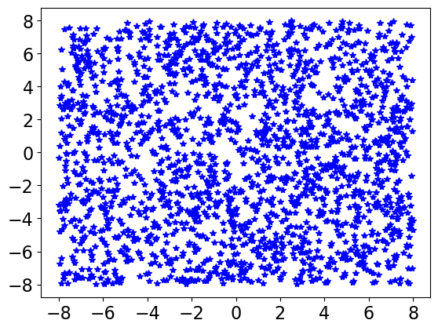
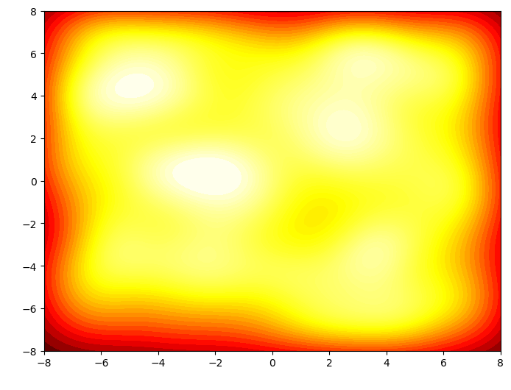
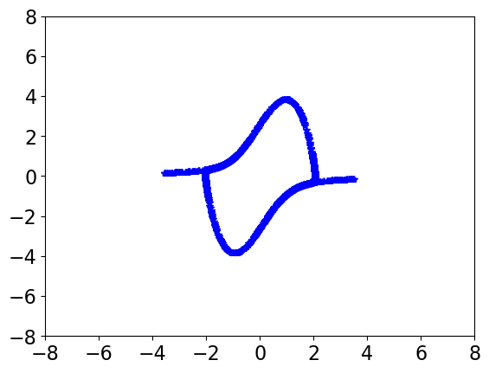
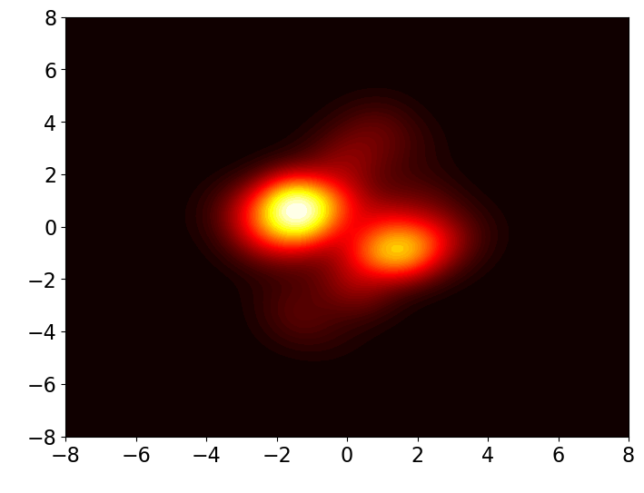
Numerical Experiments - KDE
Estimate density using Kernel Density Estimation
Initial
Final

Slide 9
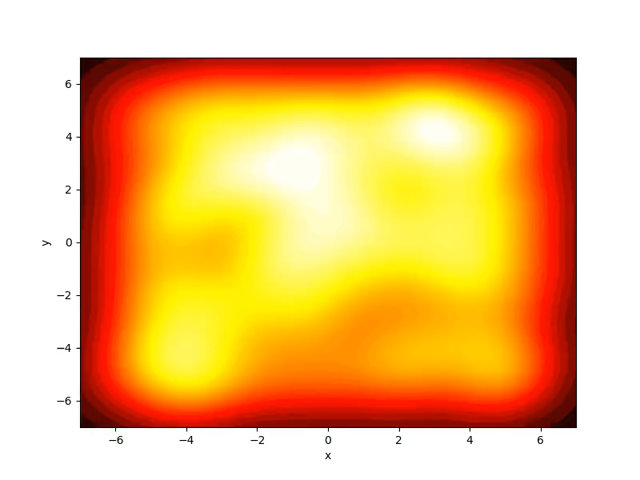
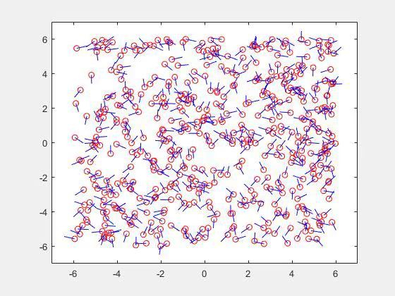
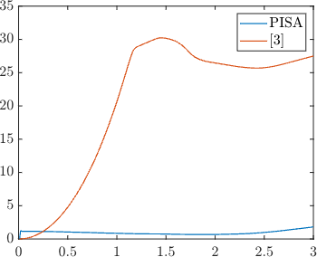
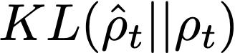
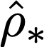
Numerical Experiments – unicycle controller
NN-based controller for unicycle
time
Dataset

Slide 10
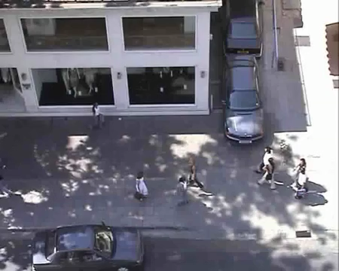
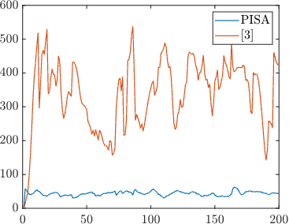
Pedestrian Dataset
time

Slide 11
Using Density Perspective for Control
Practical challenges
Only samples from initial and target sets
No knowledge of model

